Slide 1
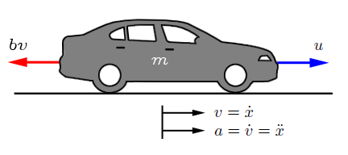

DEVELOP A VEHICLE DYNAMICS MODEL
In order to model vehicle dynamics, we draw a free body diagram to the vehicle.
The vehicle of mass m is acted upon by a control force u. The force u represents the force generated at the road/tire interface.
The resistive forces $bv$ due to rolling resistance and wind drag, are changing in a linear form with the velocity and act in an opposite direction to the vehicle.
http://ctms.engin.umich.edu/CTMS/index.php?example=CruiseControl&section=ControlPID

Slide 2

DEVELOP A VEHICLE DYNAMICS MODEL
By applying newton’s second law of motion:
$$m\ddot{x}=u−bv$$
Getting the transfer function as before:
$$mSV(s)=U(s)−bV(s)$$
Getting the output/input
$$\left(mS+b\right)V\left(s\right)=U(s)$$
Therefore
$$V\left(s\right)/U(s)=1/\left(mS+b\right)$$
http://ctms.engin.umich.edu/CTMS/index.php?example=CruiseControl&section=ControlPID

Slide 3
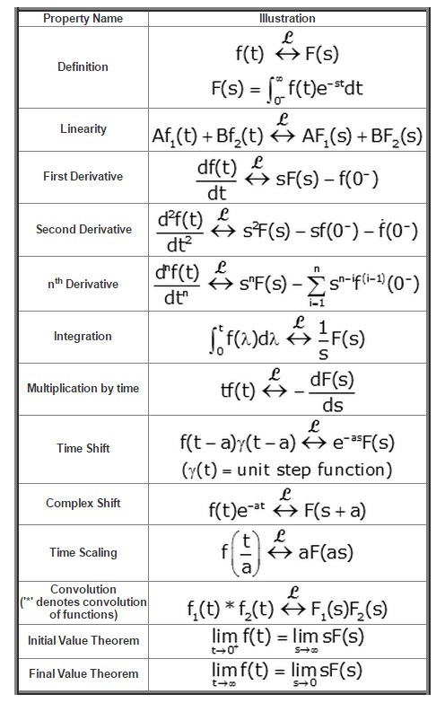
DEVELOP A VEHICLE DYNAMICS MODEL: LAPLACE TRANSOFRM

